Slide 1
Practical – 6
Machine Learning

Slide 2
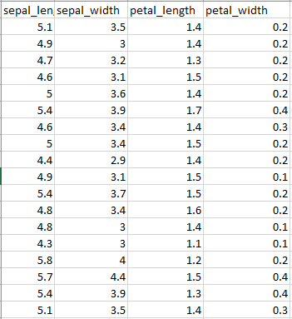
Aim:- You are given an Iris feature dataset, but you don't know which class each data point belongs to. Group all the data points into 3 clusters based on their features.
This time, we have all the features, but no target variable.

Slide 3
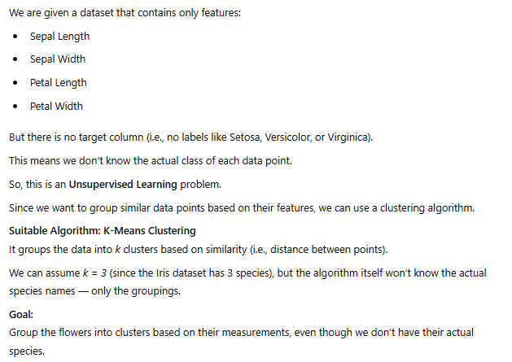

Slide 4
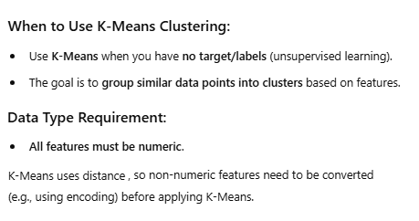

Slide 5
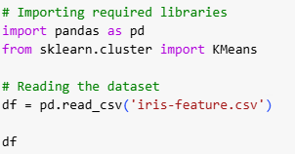
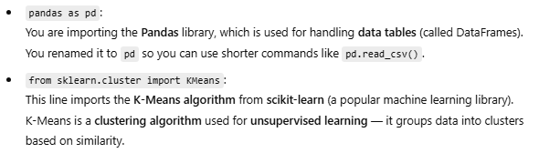

Slide 6

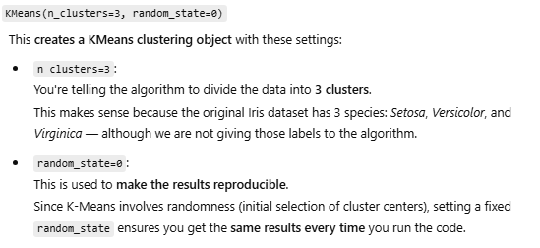


Slide 7
